Slide 1
International Consortium for Sugarcane Biotechnology - 2025
Genome assembly of brown (Puccinia melanocephala), orange (Puccinia kuehnii) and Tawny (Macruropyxis fulva) sugarcane rust pathogens
Master Student: Angie Valeria Quiñones
aquinones@cenicana.org
PI: Fernando Silva Aguilar¹
fsilvaag@cenicana.org
Co-PI: Dr. John J. Riascos¹
jjriascos@cenicana.org
Co-PI: Dr. Jhon Henry Trujillo Montenegro¹
jhtrujillo@cenicana.org
¹ CENICAÑA - Centro de Investigación de la Caña de Azúcar, (CENICAÑA),
Estación Experimental vía Cali-Florida km 26.
Valle del Cauca, Colombia
Notes:
Today, I would like to share with all of you the progress we have made regarding the project titled: Genome assembly of brown (Puccinia melanocephala) and orange (Puccinia kuehnii) sugarcane rust pathogens., wich is sponsored by the consortium.

Slide 2
Results

Slide 3
Real Dimensions of the Assembled Genomes
Genome Assembly Metric | Puccinia melanocephala (Brown Rust) | Puccinia kuehnii (Orange Rust)
Total Assembly Size | 322.68 Mb | 267.54 Mb
Repetitive Regions (%) | 58.3% | 48.6%
Number of Contigs | 1,455 | 1,557
Contig N50 | 712.3 kb | 310.1 kb
Max Contig Length | 5.92 Mb | 2.05 Mb
GC Content (%) | 38.6% | 32.7%
BUSCO Completeness (Pucciniomycetes) | 93.4% | 93.1%
Total Predicted Genes | 32,412 | 15,690
Gene Density (Genes/Mb) | 100.4 | 58.6
Summary of assembly, completeness, and annotation metrics for P. melanocephala and P. kuehnii genomes.

Slide 4
Functional distribution and paralogous expansion
in P. melanocephala and P. kuehnii genomes.
Functional and Redundancy Metric | Puccinia melanocephala (Brown Rust) | Puccinia kuehnii (Orange Rust)
Total Predicted Genes (Unique Loci) | 32,412 genes | 15,690 genes
Genes with Functional Annotation | 14,942 genes (46.1%) | 6,433 genes (41.0%)
Unique Base Genes (Orthologous Groups) | 3,276 base genes | 3,178 base genes
Strict single-copy base genes | 2,074 base genes | 2,102 base genes
Multi-copy base genes (Expanded paralogs) | 1,202 base genes | 1,076 base genes
Total redundant paralogous copies | > 11,600 copies | > 3,200 copies
Genes without Functional Annotation (Hypothetical) | 17,470 genes (53.9%) | 9,257 genes (59.0%)
Summary of functional annotation, orthologous groups, and paralogous gene expansion for P. melanocephala and P. kuehnii genomes.

Slide 5
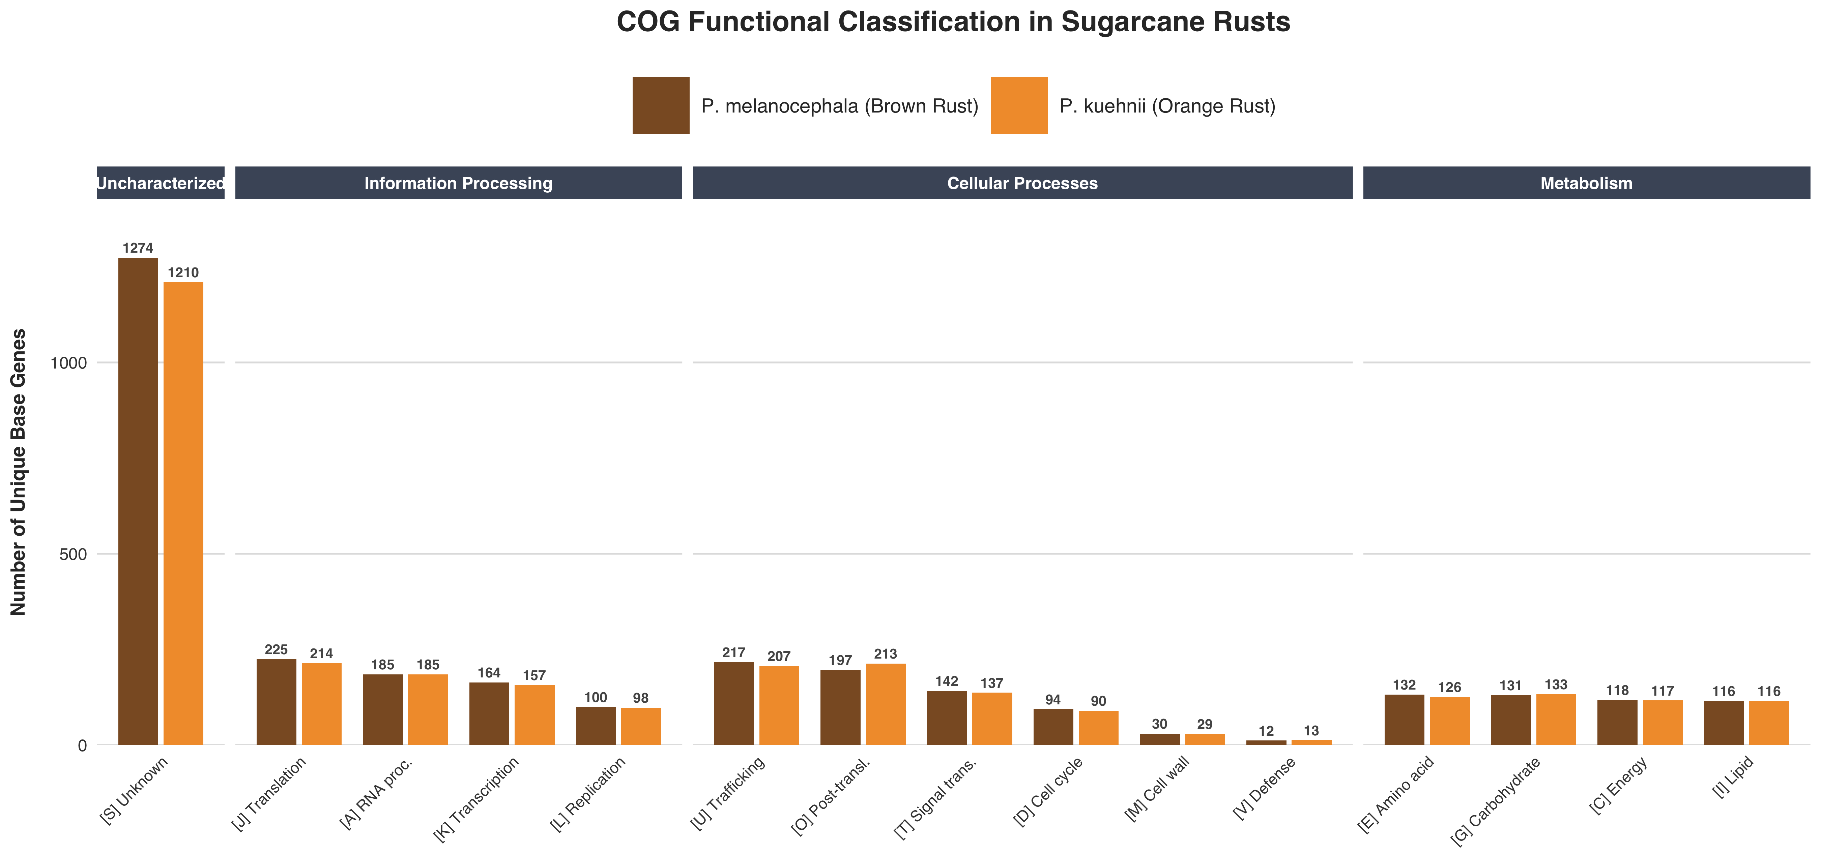
Functional distribution and paralogous expansion
in P. melanocephala and P. kuehnii genomes.
Information Processing: Core genetic machinery for DNA replication, RNA transcription, and protein synthesis.
Cellular Processes: Environmental sensing, cell wall building, and vesicular transport of toxins.
Metabolism: Processing stolen plant nutrients to generate energy (ATP) for fungal growth.
Uncharacterized: Secreted "weapons" and novel effectors used to evade sugarcane immunity.
Summary of COG functional classification and biological pathway distribution for P. melanocephala and P. kuehnii genomes.
Notes:
"Usé COG para darle al público una vista panorámica de la evolución, demostrando que ambos hongos comparten el mismo metabolismo base. Pero usé GO Terms para hacer un zoom bioquímico y entender las herramientas exactas que el hongo usa a nivel celular, dónde están ubicadas (ej. Núcleo, Mitocondria) y qué tipo de reacciones catalizan."

Slide 6
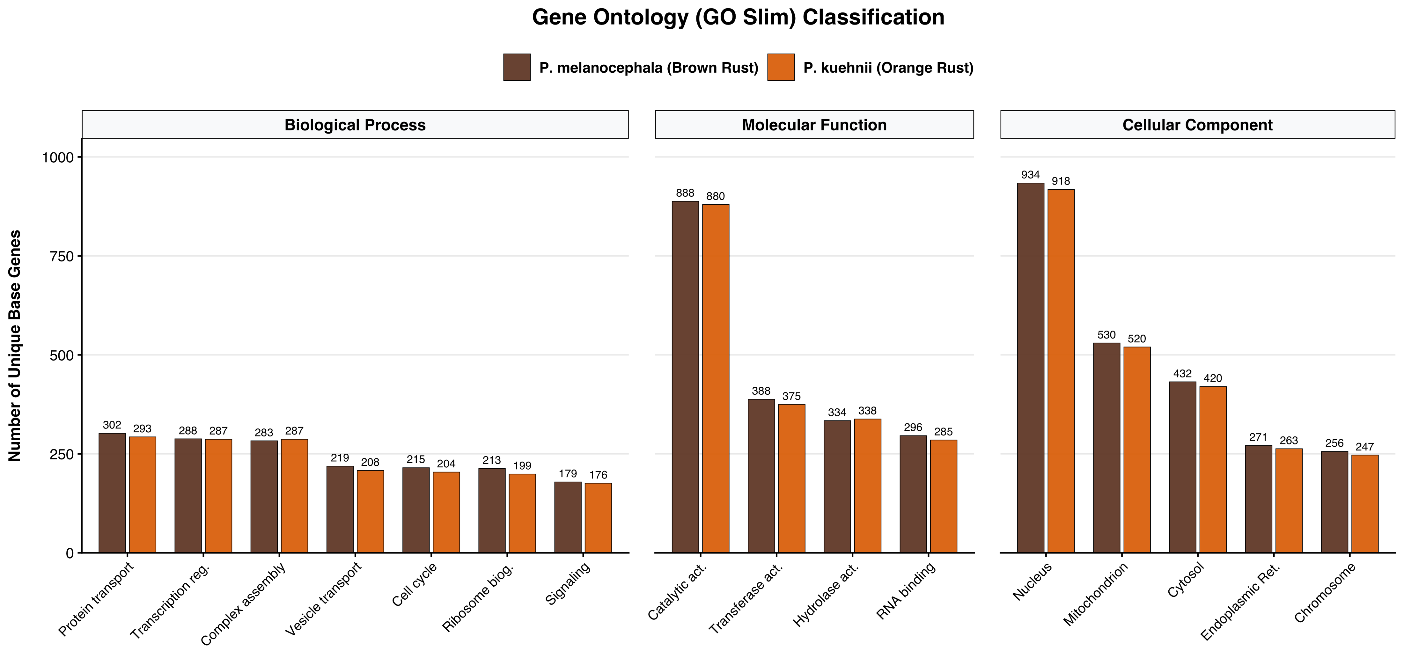
Functional distribution and paralogous expansion
in P. melanocephala and P. kuehnii genomes.
Biological Process: Broad biological goals the fungus accomplishes, such as cell cycle, transcription regulation, and vesicle-mediated transport.
Molecular Function: The exact biochemical "jobs" of the genes, heavily dominated by catalytic, transferase, and hydrolase activities required for pathogenesis.
Cellular Component: The physical cellular structures where these proteins operate, highlighting core machinery like the nucleus, mitochondrion, and endoplasmic reticulum.
Summary of Gene Ontology (GO Slim) functional classification across major biological domains for sugarcane rusts.

Slide 7
Assembly strategy performed and results.
Assembly results Brown Rust (M1)
Metric | hap1.p_ctg.fa | hap2.p_ctg.fa
# contigs | 8,904 | 4,373
Largest contig | 4.2 Mbp | 6.0 Mbp
Total length | 460 Mbp | 422 Mbp
N50 | 423 Kbp | 555 Kbp
For Haplotype 1, we obtained about 8,900 contigs, the longest contig was around 4.2 Mb, with an N50 of about 423 kb, and a total genome size close to 460 Mb.
For Haplotype 2, the assembly was more continuous: we had fewer contigs, about 4,300, the longest contig was almost 6 Mb, with a slightly higher N50 of around 556 kb, and a total size of 422 Mb.

Slide 8
Assembly strategy performed and results.
Assembly results Brown Rust (M1) after removed contamination
We assessed completeness using BUSCO.
RCM1 | Lineage | Single Copy (S) | Duplicates (D) | Fragmented (F) | Inflated (I) | Missing (M) | Total genes searched (N)
hap1.p_ctg.fa | pucciniomycetes | 87.29% (2906) | 6.55%(218) | 1.32% (44) | 0 | 4.84% (161) | 3,329
hap2.p_ctg.fa | pucciniomycetes | 87.62% (2917) | 5.80%(193) | 1.44% (48) | 0 | 5.14% (171) | 3,329
Each haplotype assembly recovered around 87% of single-copy genes, showing that most essential genes are there.
We also saw some duplicated genes, likely due to heterozygosity.
The percentage of missing genes was small, close to 5%.
Overall, this means both haplotypes are well represented.
This analysis checks how many conserved genes expected for Pucciniomycetes are present in our assemblies.
Notes:
Then we assessed completeness using BUSCO. This analysis checks how many conserved genes expected for Pucciniomycetes are present in our assemblies.
• Each haplotype assembly recovered around 87% of single-copy genes, showing that most essential genes are there.
• We also saw some duplicated genes, likely due to heterozygosity.
• The percentage of missing genes was small, between 3–5%.
Overall, this means both haplotypes are well represented, and the combined assembly is more continuous and slightly more complete

Slide 9
Assembly strategy performed and results.
Assembly results Orange Rust (M1)
We assessed completeness using BUSCO.
RNM2 | Lineage | Single Copy (S) | Duplicates (D) | Fragmented (F) | Inflated (I) | Missing (M) | Total genes searched (N)
hap2.p_ctg.fa | pucciniomycetes | 90.63 % (3017) | 2.46% (82) | 1.53% (179) | 0 | 5.38% (179) | 3,329
Tis haplotype assembly recovered around 90% of single-copy genes, showing that most essential genes are there.
Similar to Brown rust: Overall, this means this haplotypes is well represented.

